Slide 1
Opening a Mediterranean restaurant
Initial analysis:
A clustering solution

Slide 2
Agenda
Business Problem
Solution Approach
Results

Slide 3
Business Problem Layout
Interest in opening a restaurant in Toronto:
Where do we start?
Which Neighborhoods are promising candidates?
Which Neighborhoods should be immediately excluded from further review?
Notes:
Education: <= High School vs. > High School
Gender: Male/Female
Income: Treated as continuous
Purpose of Trip: Business vs. Pleasure
Relationship Status: Married/Living with Partner vs. Single/Separated

Slide 4
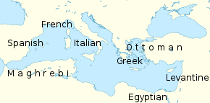
Solution Approach
Restaurants representing the countries around the Mediterranean sea are direct competitors : It will be hard to differentiate our products at the eyes of consumers. We need neighborhoods that have very few –or ideally none– of these restaurants
This Photo by Unknown Author is licensed under CC BY
Notes:
Education: <= High School vs. > High School
Gender: Male/Female
Income: Treated as continuous
Purpose of Trip: Business vs. Pleasure
Relationship Status: Married/Living with Partner vs. Single/Separated

Slide 5
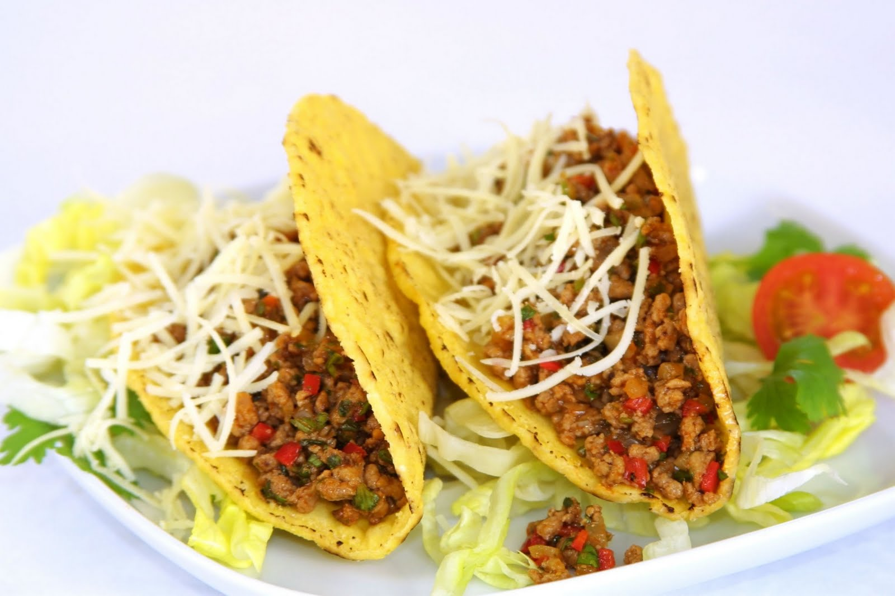
Solution Approach
Restaurants representing different ethnic cuisines are desirable: Pockets with a high concentration of ethnic restaurants attract people with an “ethnic cuisine appetite.” If these restaurants are not Mediterranean, it will be a great opportunity to differentiate our product at the eyes of consumers. We need neighborhoods that have a high concentration of these restaurants
This Photo by Unknown Author is licensed under CC BY
Notes:
Education: <= High School vs. > High School
Gender: Male/Female
Income: Treated as continuous
Purpose of Trip: Business vs. Pleasure
Relationship Status: Married/Living with Partner vs. Single/Separated

Slide 6
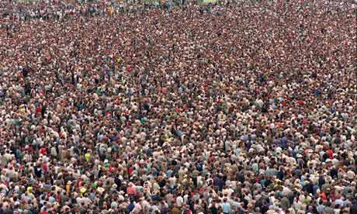
Solution Approach
Last, densely populated neighborhoods should be preferred for obvious reasons: A higher population increases the amount of opportunity for new customers
This Photo by Unknown Author is licensed under CC BY
Notes:
Education: <= High School vs. > High School
Gender: Male/Female
Income: Treated as continuous
Purpose of Trip: Business vs. Pleasure
Relationship Status: Married/Living with Partner vs. Single/Separated

Slide 7
Results
cluster | Neighborhoods | Population | residents per ethnic competitor | residents per ethnic non competitor
0 | 5 | 15,004 | 5,922 | 1,929
1 | 8 | 21,199 | 21,199 | 21,199
2 | 4 | 16,216 | 16,216 | 6,955
3 | 6 | 30,039 | 8,274 | 5,371
4 | 4 | 38,678 | 38,678 | 15,125
5 | 8 | 1,677 | 279 | 150
6 | 2 | 47,073 | 47,073 | 47,073
Cluster 4 seems to be the best cluster. It looks densely populated on average, it contains no competitor venues and a decent amount of other restaurants
Cluster 2 is also a good cluster of neighborhoods. Again no competition and a decent amount of other restaurants
Cluster 0 would be out last choice for the same reasons. It looks like the population in these neighborhoods is fairly low on average though
Refrain from the temptation to go after the heavily populated cluster 6 that has no competition. The fact that such a high population density cluster has no ethnic restaurants should be suspicious.
This Photo by Unknown Author is licensed under CC BY
Notes:
Education: <= High School vs. > High School
Gender: Male/Female
Income: Treated as continuous
Purpose of Trip: Business vs. Pleasure
Relationship Status: Married/Living with Partner vs. Single/Separated

